Slide 1
Webstore training – step by step

Slide 2
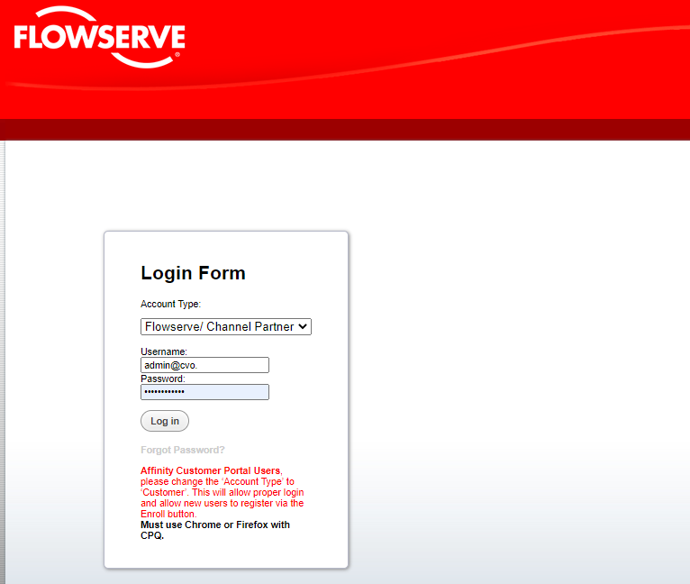
Flowserve webstore address using Google Chrome only
https://flowserve.bigmachines.com/commerce/display_company_profile.jsp?redirectUrl=%2Flogout.jsp%3F_bm_trail_refresh_%3Dtrue&hash_param=
Once in the store, please enter your username and password supplied to you by Flowserve.
Make sure you choose Flowserve/Channel Partner for your account type
Click the log in button

Slide 3
This is the home screen and on the top are different tabs that we’ll go over

Slide 4
3 Ways to Start a New Order

Slide 5
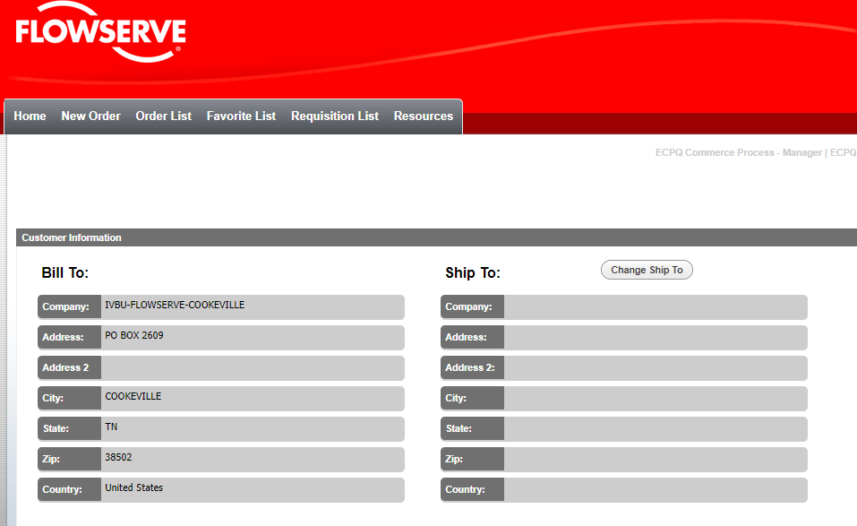
The first way to create a new order is to click the “New Order” tab and when you click on it, the screen opens up showing your bill to location for your account and a blank ship to.
To fill in the ship to location, please select the “change ship to” button and pick the circle to the left of the correct address and hit apply

Slide 6
After inserting both ship to and bill to, click on the blue arrow on the right side of the screen showing” Create Order”.

Slide 7
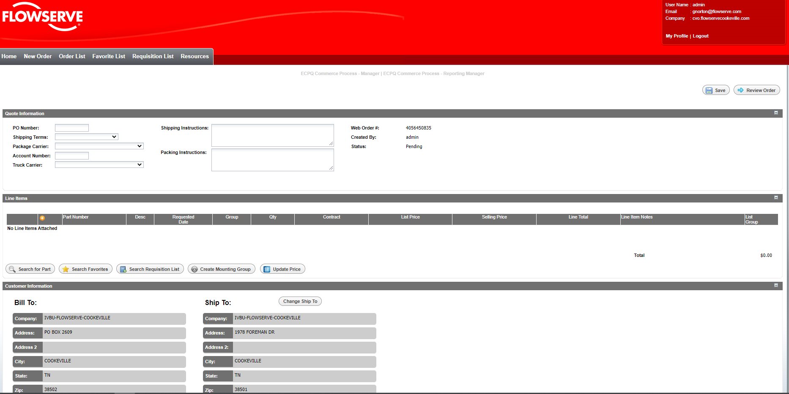
The next screen that populates is your main screen of your order.
Here you will start entering your information, starting with your po#, shipping terms as we ask for both small and heavy carrier and account information. Freight carrier information should be entered in the shipping instruction field.

Slide 8
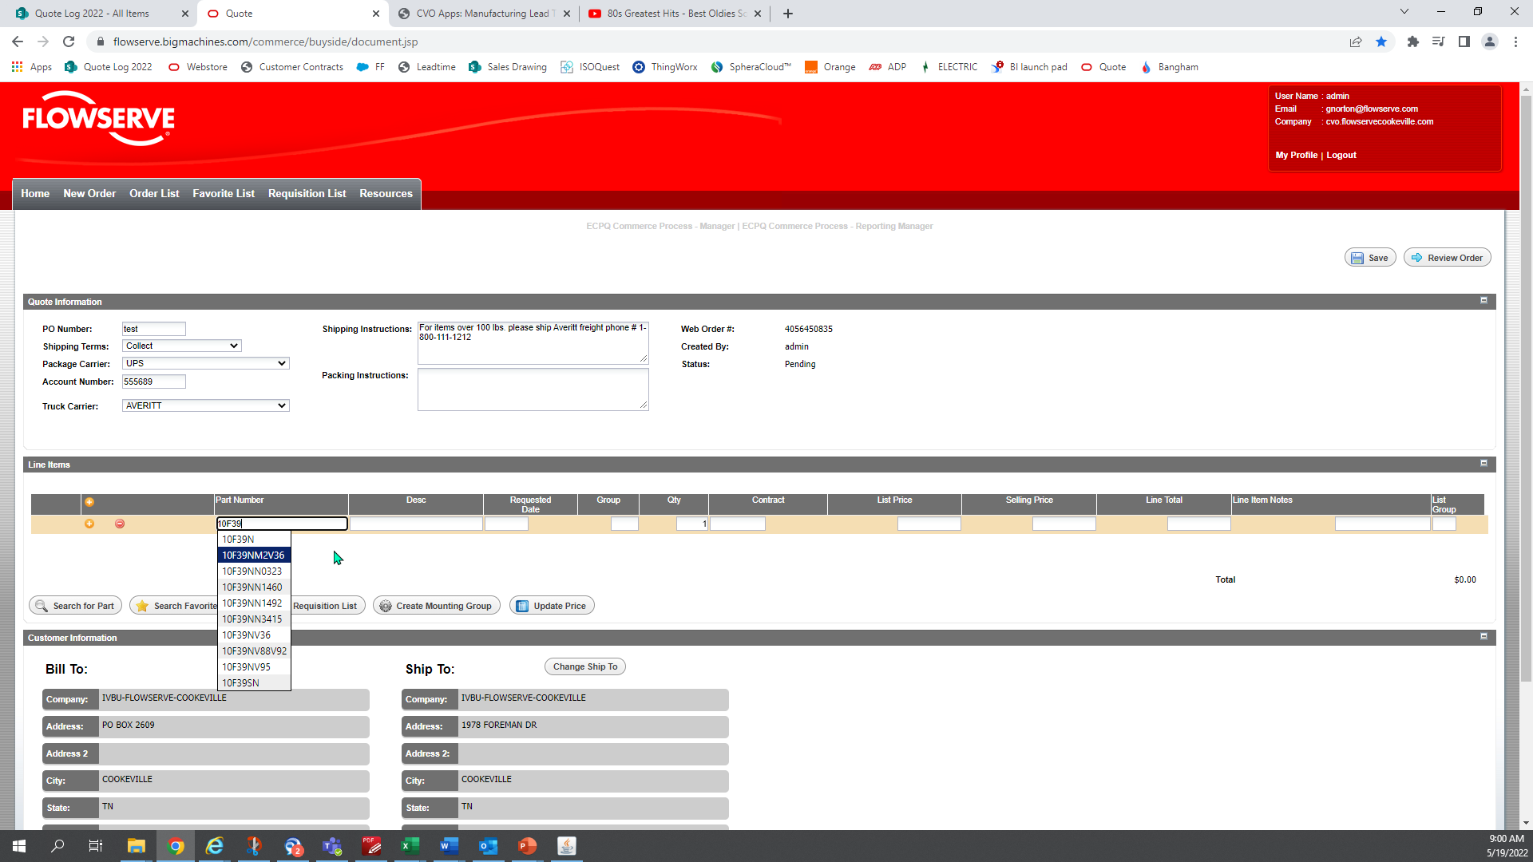
Now you are ready to start entering lines
Click on the orange circle w/the plus sign in the middle of the page and a line opens up
Start typing your part number and options start populating to help you choose which one you want
Click on the one you want or just finish typing the full part number and hit enter

Slide 9
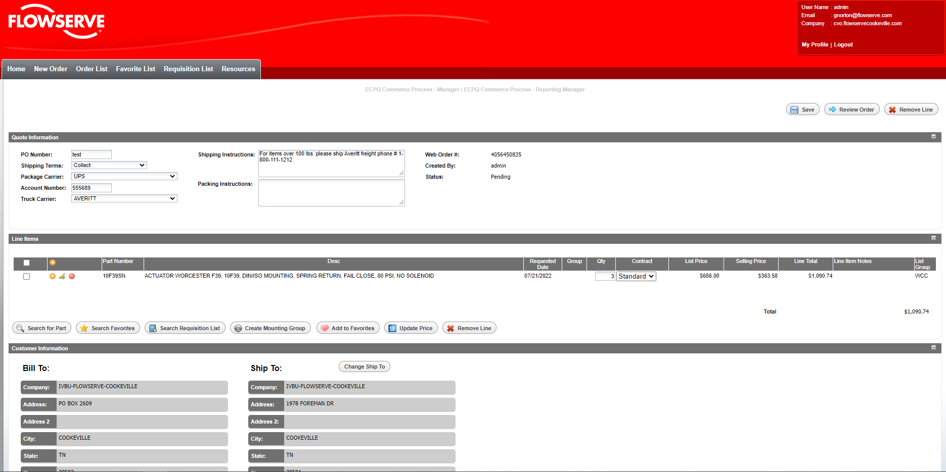
Tab or click in the quantity box and enter how many you want - You can either hit tab again and go to a new line to enter additional items or you can hit the “Update Price” button and it shows you your description, delivery if ordered today, list price and net price
If you want to keep ordering, click on the orange plus sign on this line to open a new line underneath this one

Slide 10
The second way to start a new order is to hit on the “Favorite List” tab
When it opens-up this is the screen you will see, so let’s talk more about what this list is about

Slide 11
You can add items to this “Favorite List” while in the order itself or all the way until the order is submitted by clicking in the open box on the left side of the item on the cart and clicking the “Add to Favorites” button with the heart.
You can create a new order or add to an order using this screen by clicking in the open box next to the part and clicking the top/bottom button that will say create order or add to order. Create order takes you back to slide #5.
You can edit the label from part to what your system shows our part number to be to help your receiving department easily receive in our shipments. Click on the word part under the label. Instructions are on next slide.

Slide 12
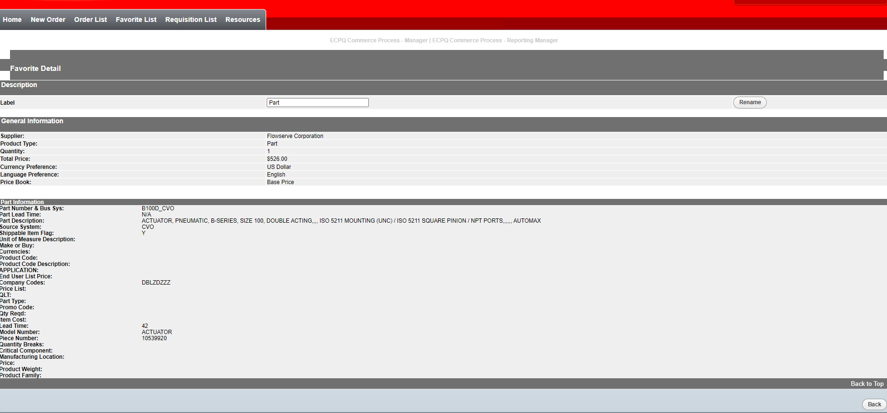
Replace the word part with your part # and click “Rename” to the right of the screen. To go back to the Favorite List tab, go to the bottom of the page to the right and click the “Back” button

Slide 13
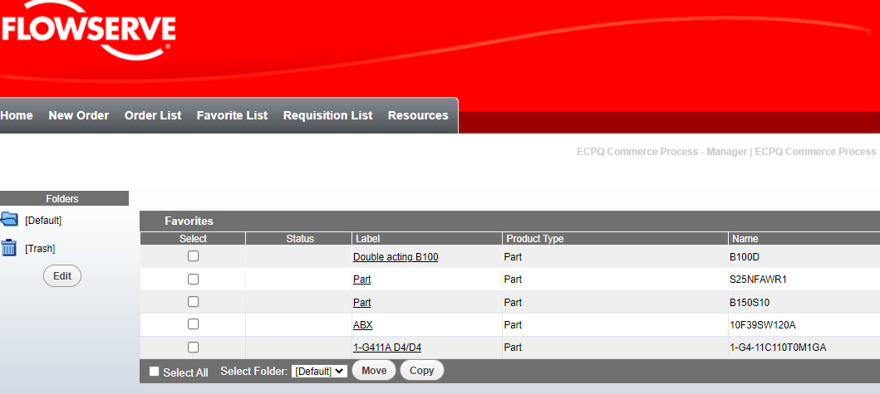
I changed the word part to “Double acting B100” and as you can see it shows both items – your part number and ours.

Slide 14
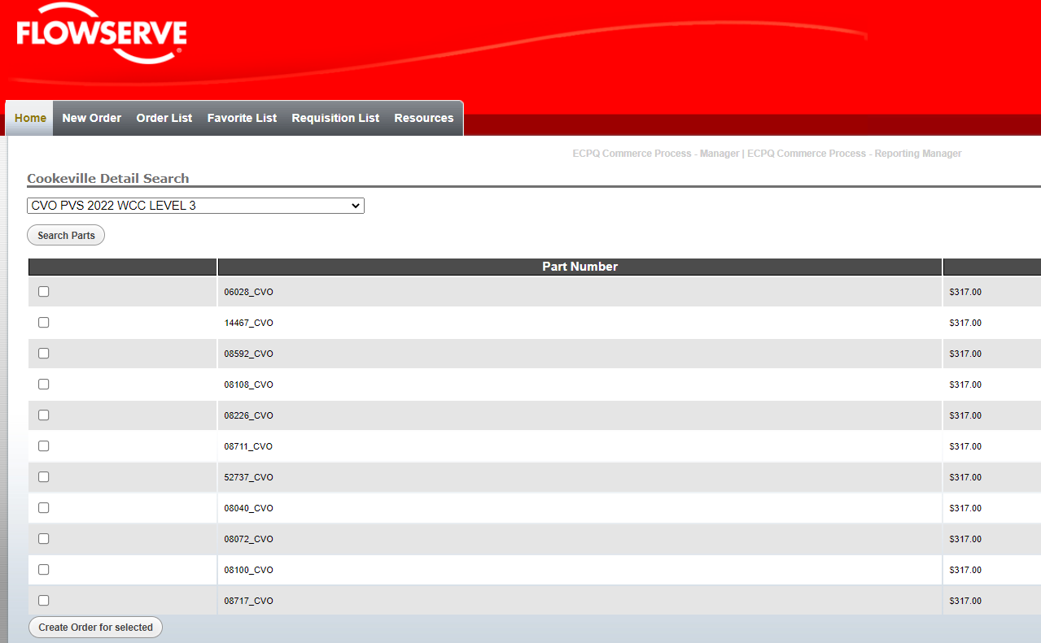
The third way to start an order is to click on the Requisition Tab then in the open slot click the down arrow and choose your price book or blanket and hit search parts
Click in the open boxes next to the items you want to add to your cart and on the bottom of the screen click either Create order or Add to order button. Create order will take you back to slide #5

Slide 15
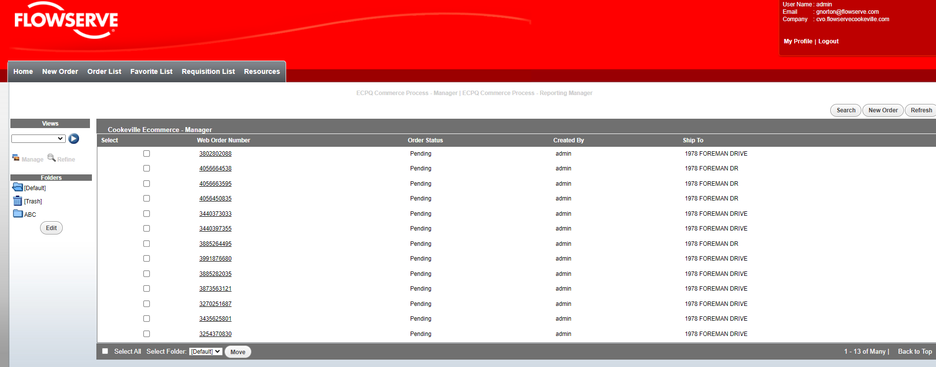
The Order List tab shows all the orders your company has started “pending” or completed “submitted”.
The last order you were in will always be on top and you’ll click the web order number to open the order. This is a good way if you start an order but don’t have time to finish it until later.
This screen is the default screen. The trash folder is really an archive folder and if you want to move items to another folder click in the open box and at the bottom of the screen click the arrow next to default and change to the folder you want and click move.

Slide 16
Creating folders in the Favorite List/Order List tabs

Slide 17
You can create folders in both the Favorites List and Order List by clicking “Edit” under the folders. It will open-up to the screen you see below. You will enter in your folder name and click “create” to the right of the page.
You can also edit folders by clicking on the folder using the down arrow on the second line of this screen and changing the name or removing the folder completely and all items will move to the trash (archive) folder.

Slide 18
Resources tab

Slide 19
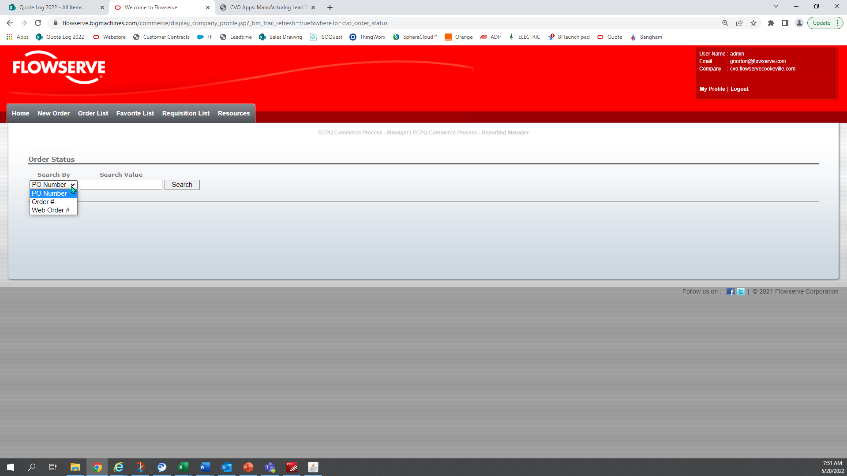
Under the Resources tab, you can look up orders by clicking Order Status. Under search by click the down arrow and choose to enter PO#, Order # or Web Order # and enter in the open field and hit search. It will show you details of your particular order selected.

Slide 20
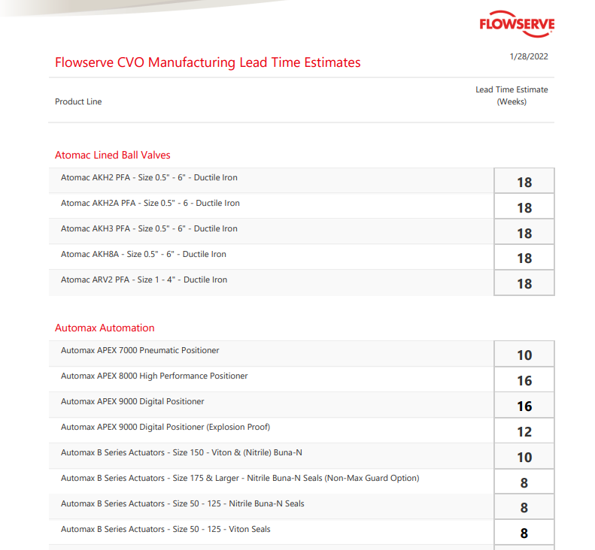
Under the Resources tab, you can click on Leadtime Chart which gives you our current guideline of our standard items for 10 pcs or below.
The webstore is live so when entering in items in your cart, the date that populates is the most accurate date to ship.

Slide 21
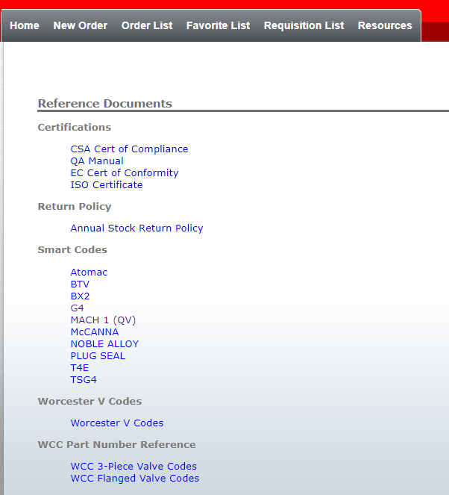
Under the Resources tab, you could click “Reference Documents” to look at items such as smart codes, ISO certs, Annual stock return policy

Slide 22
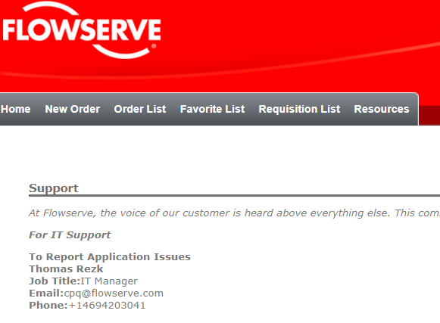
Under the Resources tab, you can click on “Support” and it will show the below contact information. Please DON’T send to Thomas Rezk, however I’ve added names and information, on this slide, who would be able to assist you for any questions for the webstore.
Gail Norton – gnorton@flowserve.com 931-432-3054
Brent Bowman - bbowman@flowserve.com 931-432-3100
Mike Lepley – mlepley@flowserve.com 931-432-3059

Slide 23
Available options while building your cart

Slide 24
You can mount 3 items in Worcester only (valve, mounting kit, actuator) by clicking the open boxes to the left of the part numbers and click the “Create Mounting Group” button below – you will see a # populate under the group heading between the Requested date and Qty showing this is mounted. If you don’t need mounted do the same things as above however hit “Unmount Mounting Group”

Slide 25
On the right the orange plus sign opens a new line, the red dash will ask you if you want to delete this line and the pencil or edit button opens a new screen to add po# notes or Stainless Steel tags to a line. We will go over this in the next slide.

Slide 26
The top portion provides a way to add notes to a line on documentation such as shippers & acknowledgments
The bottom half of the screen is for SS tags. A free perk while utilizing the store. Tag 1 and Tag 2 are really lines 1 and 2 as each line only holds 17 characters.
Once completed with this screen click the “Save” then “Back” buttons at the top right of the screen.

Slide 27
Let me start by saying the “Search for Part” button below takes a long time to search and just spins. Please if you need help looking for a part# while entering on the main screen, reach out to someone on slide # 23
The “Search Favorites and “Search Requisition List” button will take you to these tabs while still working on your order so you can add items to your cart.
The “Create Mounting Group” and “Unmount Mounting Group” is explained on slide # 25
The “Update Price” button is how you populate descriptions, delivery, list price and net price in your cart – also explained on slide # 9
The “Remove Line” button is used when you want to delete more than one item at a time by clicking in the open boxes next to the items and click Remove Line and they all get deleted.

Slide 28
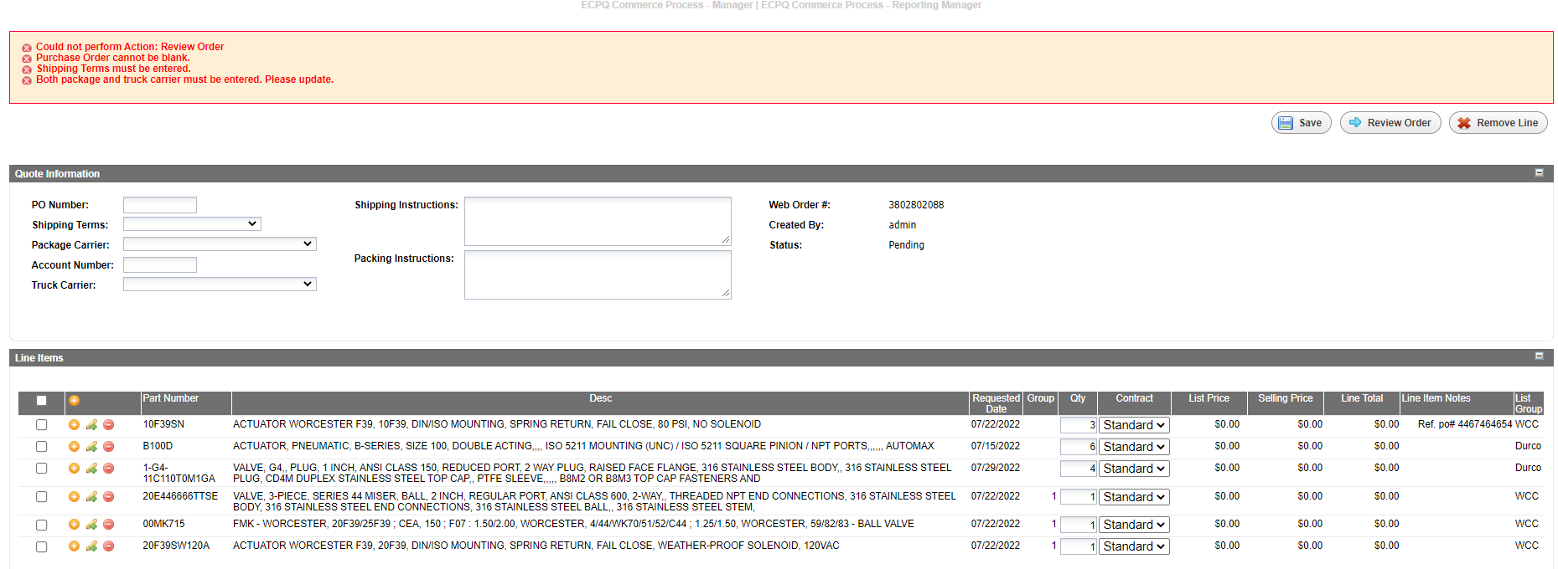
To submit your order, you will click on the blue arrow showing “Review Order” which is the last screen you see before you hit the submit button. However if you have any errors it will not move to this page and show you the errors in red. This order failed due to not having the po# and shipping terms filled out

Slide 29
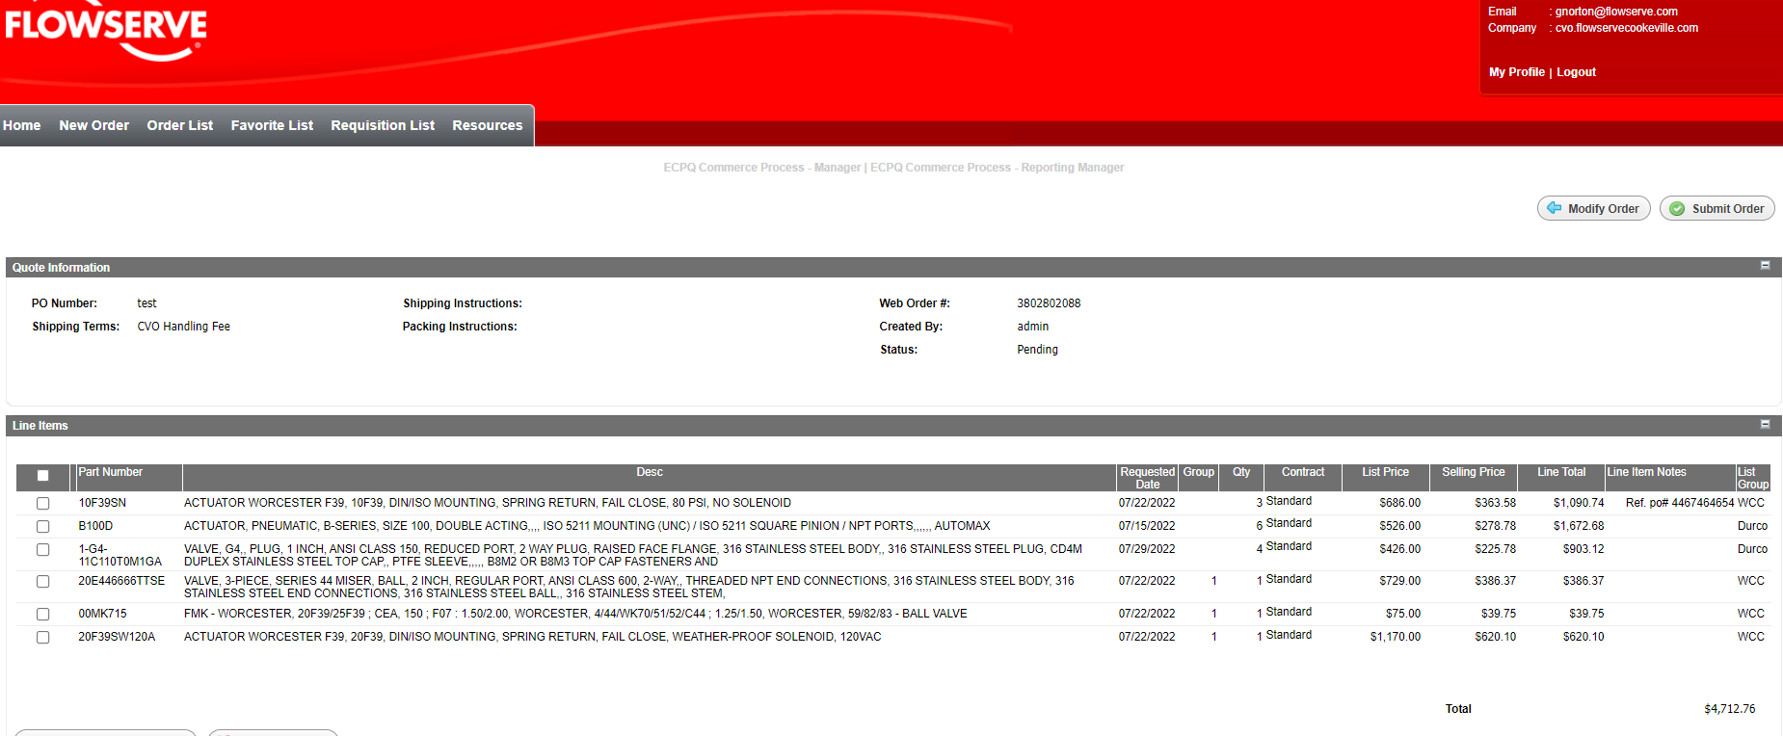
Once errors are corrected, you will click on “Review order” and it takes you to the last screen you see before hitting the “Submit Order” button at the top right of the screen. After submitting your order, you will receive an emailed acknowledgment in 11 seconds.

